Slide 1
Day 8: Configure CI Workflow
GitHub Security • Secrets • Environments • GHCR • Azure App Service • QA Gates
Code
CI
Docker
GHCR
DEV
QA Gate
QA
Day 8 Configure CI Workflow | 1/100

Slide 2
Day 8 Learning Objectives
Explain CI vs CD
Secure GitHub Actions using permissions, secrets and environments
Create workflow YAML with triggers, jobs, steps and conditions
Build and push Docker image to GHCR
Deploy to Azure App Service DEV and gated QA
push
test
build
deploy
Day 8 Configure CI Workflow | 2/100

Slide 3
Day 8 TOC
GitHub security lab
Create secrets and connections
Deployment environments
Create CI workflow
Push Docker image to GHCR
Create Azure App Service
Configure CD/release workflow
Variables, schedules, triggers, gates
push
test
build
deploy
Day 8 Configure CI Workflow | 3/100

Slide 4
Business Scenario
Cencora-style sample: Pharmaceutical Order API
Hospitals/pharmacies submit sample medicine orders
No real healthcare or commercial data
Deploy same artifact to DEV and QA
Use CI/CD to reduce manual release errors
push
test
build
deploy
Day 8 Configure CI Workflow | 4/100

Slide 5
Target Architecture
Developer pushes code
GitHub Actions builds and tests
Docker image is pushed to GHCR
DEV App Service updates automatically
QA App Service updates only after approval
Code
Build
Image
DEV
Gate
QA
Day 8 Configure CI Workflow | 5/100

Slide 6
Build Once, Deploy Many
Build container image once
Tag with commit SHA
Deploy same SHA image to DEV
Promote same image to QA
Avoid rebuilding a different QA artifact
Code
Build
Image
DEV
Gate
QA
Day 8 Configure CI Workflow | 6/100

Slide 7
CI vs CD
CI: build and validate every change
CD: deliver verified artifact to environment
Release workflow adds approval and governance
CI protects code quality
CD protects deployment consistency
push
test
build
deploy
Day 8 Configure CI Workflow | 7/100

Slide 8
Repository Setup
Create cencora-order-api-sNN
Add app source code
Add Dockerfile
Add .github/workflows folder
Commit to main branch
push
test
build
deploy
Day 8 Configure CI Workflow | 8/100

Slide 9
Sample API Endpoints
GET /health returns service status
POST /orders accepts sample order payload
Validation checks required fields
Returns 202 Accepted for valid order
Use dummy data only
push
test
build
deploy
Day 8 Configure CI Workflow | 9/100

Slide 10
GitHub Actions Concepts
Workflow is YAML file
Event triggers workflow
Job runs on runner
Step runs action or command
Runner is temporary execution machine
push
test
build
deploy
Day 8 Configure CI Workflow | 10/100

Slide 11
Workflow File Location
Folder must be .github/workflows
File extension .yml or .yaml
YAML is committed to repository
Each file becomes a workflow
Actions tab shows workflow runs
push
test
build
deploy
Day 8 Configure CI Workflow | 11/100

Slide 12
YAML Indentation
YAML uses spaces
Incorrect indentation breaks parsing
Case and key names matter
Use GitHub editor validation
Commit small changes and test
push
test
build
deploy
Day 8 Configure CI Workflow | 12/100

Slide 13
Workflow name
name appears in Actions tab
Choose readable names
Example: Day 8 CI CD to Azure App Service
Helps troubleshooting
Helps trainer identify student runs
push
test
build
deploy
Day 8 Configure CI Workflow | 13/100

Slide 14
Triggers Overview
push for commits
pull_request for PR validation
workflow_dispatch for manual release
schedule for timed automation
Multiple triggers can coexist
push
test
build
deploy
Day 8 Configure CI Workflow | 14/100

Slide 15
Push Trigger
Runs when code reaches main
Good for automatic DEV deployment
Avoid pushing every branch to environments
Use branch filters
Combine with protected main branch
push
test
build
deploy
Day 8 Configure CI Workflow | 15/100

Slide 16
Pull Request Trigger
Runs validation before merge
Should not deploy to shared environments
Should not push final images unless approved
Use conditions to skip publish
Protects main branch quality
push
test
build
deploy
Day 8 Configure CI Workflow | 16/100

Slide 17
Manual Trigger
workflow_dispatch creates Run workflow button
Useful for release to QA
Can accept inputs
Trainer can demo without new commit
Good for controlled release exercises
push
test
build
deploy
Day 8 Configure CI Workflow | 17/100

Slide 18
Schedule Trigger
Uses cron syntax
Cron evaluated in UTC
Useful for nightly checks
Can run smoke tests
Do not use for unnecessary costly jobs
push
test
build
deploy
Day 8 Configure CI Workflow | 18/100

Slide 19
Permissions Block
Defines GITHUB_TOKEN permissions
contents: read for checkout
packages: write for GHCR push
Use least privilege
Avoid broad write access
push
test
build
deploy
Day 8 Configure CI Workflow | 19/100

Slide 20
Secrets
Encrypted sensitive values
Referenced as secrets.NAME
Masked in logs
Used for publish profiles/tokens
Never echo secrets intentionally
push
test
build
deploy
Day 8 Configure CI Workflow | 20/100

Slide 21
Variables
Non-sensitive configuration
Referenced as vars.NAME
Good for app names
Good for image names
Do not place passwords in variables
push
test
build
deploy
Day 8 Configure CI Workflow | 21/100

Slide 22
Secret vs Variable
Secret: credential/private key/token
Variable: resource name/config value
Secret values hidden
Variable values visible to maintainers
Use correct scope
push
test
build
deploy
Day 8 Configure CI Workflow | 22/100

Slide 23
Environment Secrets
Attached to environment
DEV secret only for DEV
QA secret only for QA
Reduces blast radius
Works with environment gates
push
test
build
deploy
Day 8 Configure CI Workflow | 23/100

Slide 24
Deployment Environments
Represent targets like development and qa
Show deployment history
Can require reviewers
Can restrict branches
Can scope secrets
push
test
build
deploy
Day 8 Configure CI Workflow | 24/100

Slide 25
QA Gate
QA job references environment: qa
GitHub pauses job
Reviewer approves deployment
Then job continues
Models real release governance
push
test
build
deploy
Day 8 Configure CI Workflow | 25/100

Slide 26
Runner
runs-on selects runner image
ubuntu-latest common for Docker builds
Runner is ephemeral
Install dependencies inside job
Do not assume state between jobs
push
test
build
deploy
Day 8 Configure CI Workflow | 26/100

Slide 27
Job Chaining
needs creates dependencies
deploy_dev needs docker_build_push
deploy_qa needs dev deployment
Failure stops dependent jobs
Makes pipeline readable
push
test
build
deploy
Day 8 Configure CI Workflow | 27/100

Slide 28
Checkout Step
actions/checkout pulls repository
Usually first step
Required before building/testing
Version v4 commonly used
No source means no build
push
test
build
deploy
Day 8 Configure CI Workflow | 28/100

Slide 29
Setup Python Step
actions/setup-python installs runtime
Version controlled by env variable
Makes runner consistent
Helps repeatability
Can cache dependencies if needed
push
test
build
deploy
Day 8 Configure CI Workflow | 29/100

Slide 30
Build Job
Install dependencies
Compile/check application
Run unit tests if present
Fail fast on errors
No deployment from failed build
push
test
build
deploy
Day 8 Configure CI Workflow | 30/100

Slide 31
Docker Build Job
Login to GHCR
Create image tag
Build Docker image
Tag latest and SHA
Push to registry
push
test
build
deploy
Day 8 Configure CI Workflow | 31/100

Slide 32
GHCR
GitHub Container Registry
Image path starts ghcr.io
Uses packages permission
Stores image versions/tags
Can be public/private based on policy
push
test
build
deploy
Day 8 Configure CI Workflow | 32/100

Slide 33
Docker Image Tagging
latest is mutable
SHA tag is immutable-style
sha-b95d3e1 ties image to commit
Use SHA tag for release
Use latest only for convenience
push
test
build
deploy
Day 8 Configure CI Workflow | 33/100

Slide 34
Azure App Service
PaaS hosting service
Can run code or container
Linux container for this lab
DEV and QA as separate apps
Validate through default domain
push
test
build
deploy
Day 8 Configure CI Workflow | 34/100

Slide 35
Publish Profile
App-level credential
Downloaded from App Service
Stored as GitHub secret
Simple for training
Production prefers OIDC/workload identity
push
test
build
deploy
Day 8 Configure CI Workflow | 35/100

Slide 36
OIDC Note
Avoids long-lived secrets
Uses federated identity trust
Recommended for production
Requires Entra/App identity setup
Publish profile used for simpler lab
push
test
build
deploy
Day 8 Configure CI Workflow | 36/100

Slide 37
Deployment Job
Uses azure/webapps-deploy
App name from vars
Publish profile from secrets
Image from GHCR SHA tag
Updates App Service container image
push
test
build
deploy
Day 8 Configure CI Workflow | 37/100

Slide 38
DEV Deployment
Automatic after main push
Fast feedback environment
Should use dev-specific secret
Smoke test /health
Review logs if failure
push
test
build
deploy
Day 8 Configure CI Workflow | 38/100

Slide 39
QA Deployment
Manual workflow input
QA environment approval
Same image tag as DEV
Controlled release
Validation after deployment
push
test
build
deploy
Day 8 Configure CI Workflow | 39/100

Slide 40
Conditions
if controls job or step
Skip image push on pull_request
Run QA only for manual release input
Avoid unsafe deployments
Read logs for skipped jobs
push
test
build
deploy
Day 8 Configure CI Workflow | 40/100

Slide 41
Outputs
One job can expose values
Image tag output used by deploy jobs
Avoid recomputing release identifiers
Improves traceability
Useful in multi-job workflows
push
test
build
deploy
Day 8 Configure CI Workflow | 41/100

Slide 42
Concurrency
Avoid two deployments fighting
Cancel older pending runs if desired
Protect same environment
Useful for real teams
Optional advanced concept today
push
test
build
deploy
Day 8 Configure CI Workflow | 42/100

Slide 43
GitHub Security Lab Flow
Check Actions permissions
Create secrets/variables
Create environments
Use least privilege permissions
Review workflow logs for leaks
push
test
build
deploy
Day 8 Configure CI Workflow | 43/100

Slide 44
Branch Protection
Require pull request
Require checks to pass
Restrict direct pushes
Enforce review process
Plan-dependent feature availability
push
test
build
deploy
Day 8 Configure CI Workflow | 44/100

Slide 45
Package Visibility
Private package needs registry access
Public package easier for dummy lab
Enterprise should control visibility
Avoid sensitive app/data in public packages
Use ACR for production option
push
test
build
deploy
Day 8 Configure CI Workflow | 45/100

Slide 46
Azure App Settings
Container port may need WEBSITES_PORT=8080
App Service restart after image change
Check Configuration blade
Use logs for startup failure
Keep values non-secret or use secure settings
push
test
build
deploy
Day 8 Configure CI Workflow | 46/100

Slide 47
Validation Commands
GET /health
POST /orders
Check HTTP status
Check deployment logs
Confirm image tag
push
test
build
deploy
Day 8 Configure CI Workflow | 47/100

Slide 48
Troubleshooting Strategy
Find failed job
Open failed step log
Read exact error
Map to permission/secret/YAML/Azure/runtime
Fix one issue at a time
push
test
build
deploy
Day 8 Configure CI Workflow | 48/100

Slide 49
Common Error: YAML
Parser error
Wrong indentation
Missing colon
Tabs used accidentally
Fix in GitHub editor
push
test
build
deploy
Day 8 Configure CI Workflow | 49/100

Slide 50
Common Error: GHCR denied
packages: write missing
Workflow permissions too restrictive
Package namespace mismatch
Private package access issue
Check login-action credentials
push
test
build
deploy
Day 8 Configure CI Workflow | 50/100

Slide 51
Common Error: Deploy failed
Wrong App Service name
Wrong publish profile
Expired/rotated credential
Wrong image path
Azure app cannot pull image
push
test
build
deploy
Day 8 Configure CI Workflow | 51/100

Slide 52
Common Error: App fails to start
Wrong port
Missing dependency
Bad Docker CMD
Image not reachable
Use Log stream
push
test
build
deploy
Day 8 Configure CI Workflow | 52/100

Slide 53
YAML Node: name
Human-readable workflow name shown in the Actions tab.
Ask students to locate this node in the workflow
Explain why it exists
Explain what breaks if it is wrong
Relate it to the Day 8 pipeline
push
test
build
deploy
Day 8 Configure CI Workflow | 53/100

Slide 54
YAML Node: on
Defines events that trigger the workflow.
Ask students to locate this node in the workflow
Explain why it exists
Explain what breaks if it is wrong
Relate it to the Day 8 pipeline
push
test
build
deploy
Day 8 Configure CI Workflow | 54/100

Slide 55
YAML Node: push
Runs workflow when commits are pushed to matching branches.
Ask students to locate this node in the workflow
Explain why it exists
Explain what breaks if it is wrong
Relate it to the Day 8 pipeline
push
test
build
deploy
Day 8 Configure CI Workflow | 55/100

Slide 56
YAML Node: pull_request
Validates code before merging.
Ask students to locate this node in the workflow
Explain why it exists
Explain what breaks if it is wrong
Relate it to the Day 8 pipeline
push
test
build
deploy
Day 8 Configure CI Workflow | 56/100

Slide 57
YAML Node: workflow_dispatch
Manual button to run the workflow.
Ask students to locate this node in the workflow
Explain why it exists
Explain what breaks if it is wrong
Relate it to the Day 8 pipeline
push
test
build
deploy
Day 8 Configure CI Workflow | 57/100

Slide 58
YAML Node: schedule
Cron-based run in UTC.
Ask students to locate this node in the workflow
Explain why it exists
Explain what breaks if it is wrong
Relate it to the Day 8 pipeline
push
test
build
deploy
Day 8 Configure CI Workflow | 58/100

Slide 59
YAML Node: permissions
Limits what GITHUB_TOKEN can do.
Ask students to locate this node in the workflow
Explain why it exists
Explain what breaks if it is wrong
Relate it to the Day 8 pipeline
push
test
build
deploy
Day 8 Configure CI Workflow | 59/100

Slide 60
YAML Node: env
Workflow-level environment variables.
Ask students to locate this node in the workflow
Explain why it exists
Explain what breaks if it is wrong
Relate it to the Day 8 pipeline
push
test
build
deploy
Day 8 Configure CI Workflow | 60/100

Slide 61
YAML Node: jobs
Top-level collection of work units.
Ask students to locate this node in the workflow
Explain why it exists
Explain what breaks if it is wrong
Relate it to the Day 8 pipeline
push
test
build
deploy
Day 8 Configure CI Workflow | 61/100

Slide 62
YAML Node: runs-on
Runner VM image used by the job.
Ask students to locate this node in the workflow
Explain why it exists
Explain what breaks if it is wrong
Relate it to the Day 8 pipeline
push
test
build
deploy
Day 8 Configure CI Workflow | 62/100

Slide 63
YAML Node: steps
Ordered commands/actions inside a job.
Ask students to locate this node in the workflow
Explain why it exists
Explain what breaks if it is wrong
Relate it to the Day 8 pipeline
push
test
build
deploy
Day 8 Configure CI Workflow | 63/100

Slide 64
YAML Node: uses
References a reusable GitHub Action.
Ask students to locate this node in the workflow
Explain why it exists
Explain what breaks if it is wrong
Relate it to the Day 8 pipeline
push
test
build
deploy
Day 8 Configure CI Workflow | 64/100

Slide 65
YAML Node: run
Runs shell commands.
Ask students to locate this node in the workflow
Explain why it exists
Explain what breaks if it is wrong
Relate it to the Day 8 pipeline
push
test
build
deploy
Day 8 Configure CI Workflow | 65/100

Slide 66
YAML Node: with
Inputs passed to an action.
Ask students to locate this node in the workflow
Explain why it exists
Explain what breaks if it is wrong
Relate it to the Day 8 pipeline
push
test
build
deploy
Day 8 Configure CI Workflow | 66/100

Slide 67
YAML Node: needs
Creates job dependency chain.
Ask students to locate this node in the workflow
Explain why it exists
Explain what breaks if it is wrong
Relate it to the Day 8 pipeline
push
test
build
deploy
Day 8 Configure CI Workflow | 67/100

Slide 68
YAML Node: if
Conditional execution.
Ask students to locate this node in the workflow
Explain why it exists
Explain what breaks if it is wrong
Relate it to the Day 8 pipeline
push
test
build
deploy
Day 8 Configure CI Workflow | 68/100

Slide 69
YAML Node: outputs
Passes values from one job to another.
Ask students to locate this node in the workflow
Explain why it exists
Explain what breaks if it is wrong
Relate it to the Day 8 pipeline
push
test
build
deploy
Day 8 Configure CI Workflow | 69/100

Slide 70
YAML Node: environment
Links job to GitHub environment and gates.
Ask students to locate this node in the workflow
Explain why it exists
Explain what breaks if it is wrong
Relate it to the Day 8 pipeline
push
test
build
deploy
Day 8 Configure CI Workflow | 70/100

Slide 71
YAML Node: secrets
Sensitive values encrypted by GitHub.
Ask students to locate this node in the workflow
Explain why it exists
Explain what breaks if it is wrong
Relate it to the Day 8 pipeline
push
test
build
deploy
Day 8 Configure CI Workflow | 71/100

Slide 72
YAML Node: vars
Non-sensitive reusable config values.
Ask students to locate this node in the workflow
Explain why it exists
Explain what breaks if it is wrong
Relate it to the Day 8 pipeline
push
test
build
deploy
Day 8 Configure CI Workflow | 72/100

Slide 73
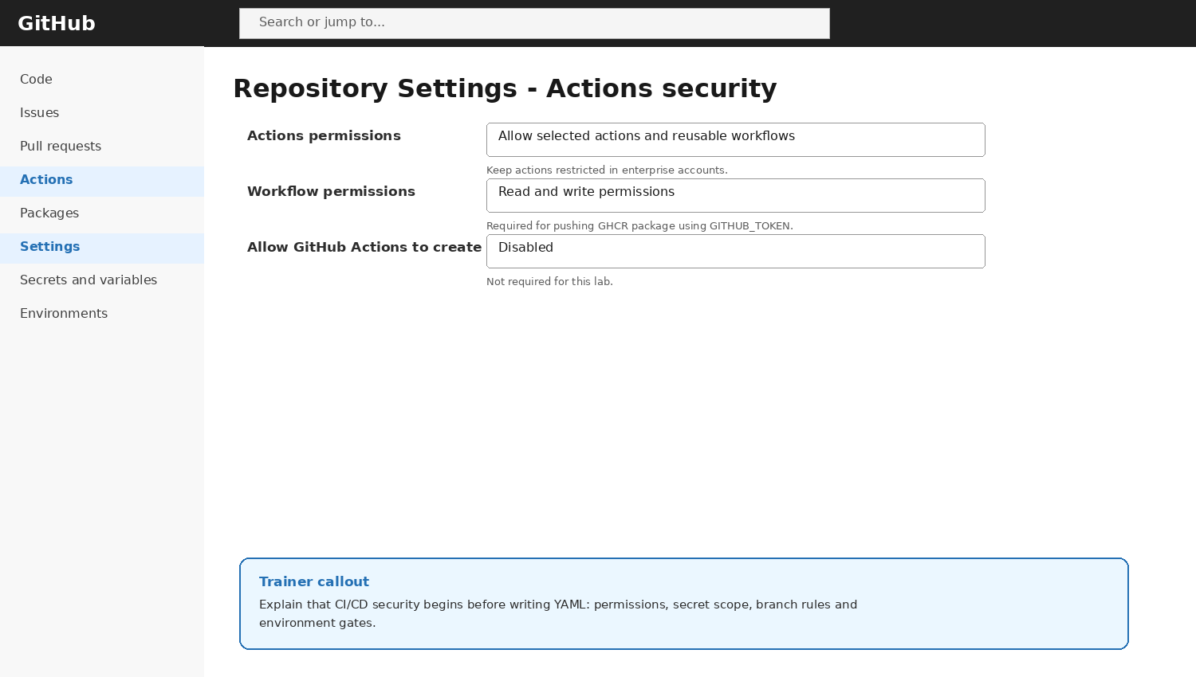
GitHub Actions Security UI
Show this screen during guided walkthrough
Explain values students must enter
Explain what not to change
Validate before proceeding
Capture screenshot for evidence
Day 8 Configure CI Workflow | 73/100

Slide 74

Secrets and Variables UI
Show this screen during guided walkthrough
Explain values students must enter
Explain what not to change
Validate before proceeding
Capture screenshot for evidence
Day 8 Configure CI Workflow | 74/100

Slide 75
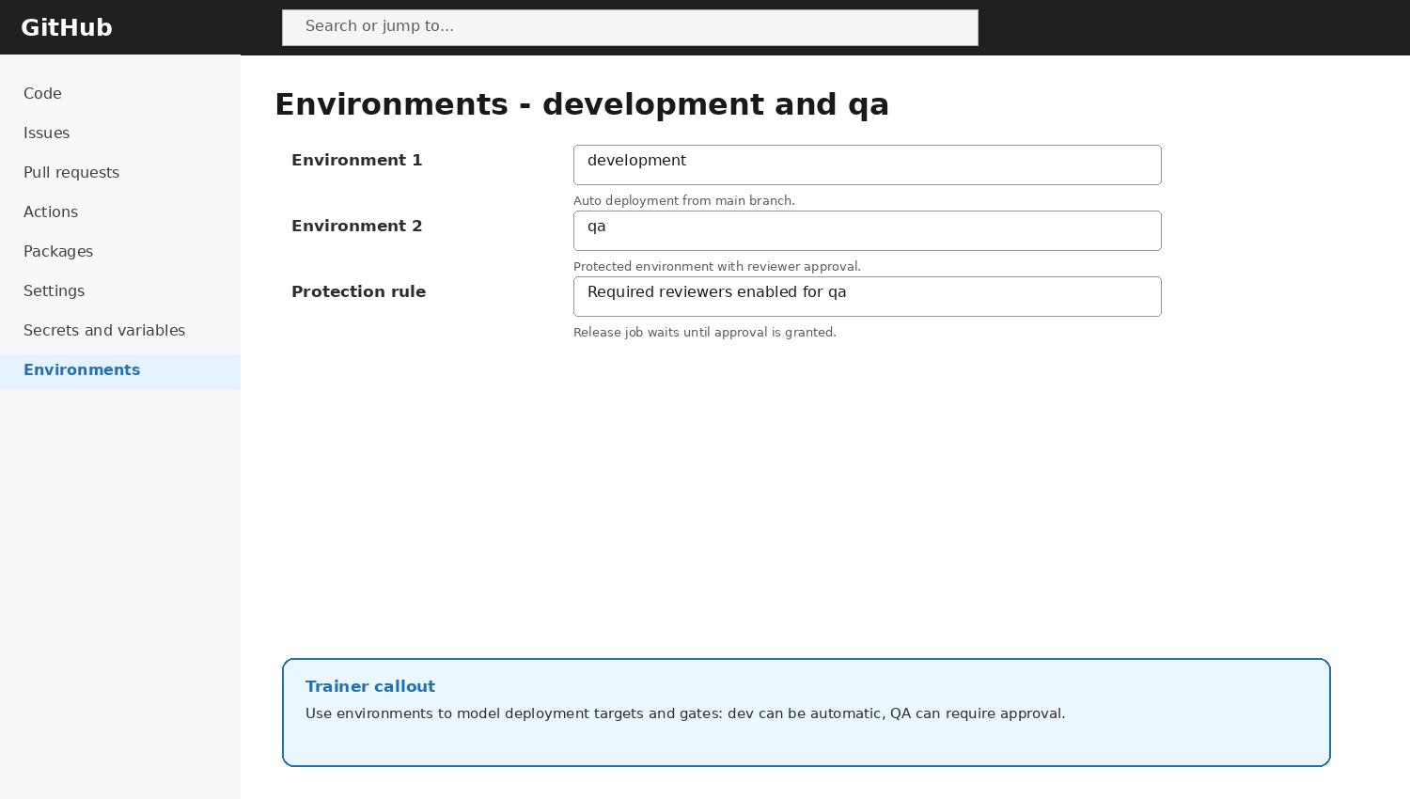
Deployment Environments UI
Show this screen during guided walkthrough
Explain values students must enter
Explain what not to change
Validate before proceeding
Capture screenshot for evidence
Day 8 Configure CI Workflow | 75/100

Slide 76
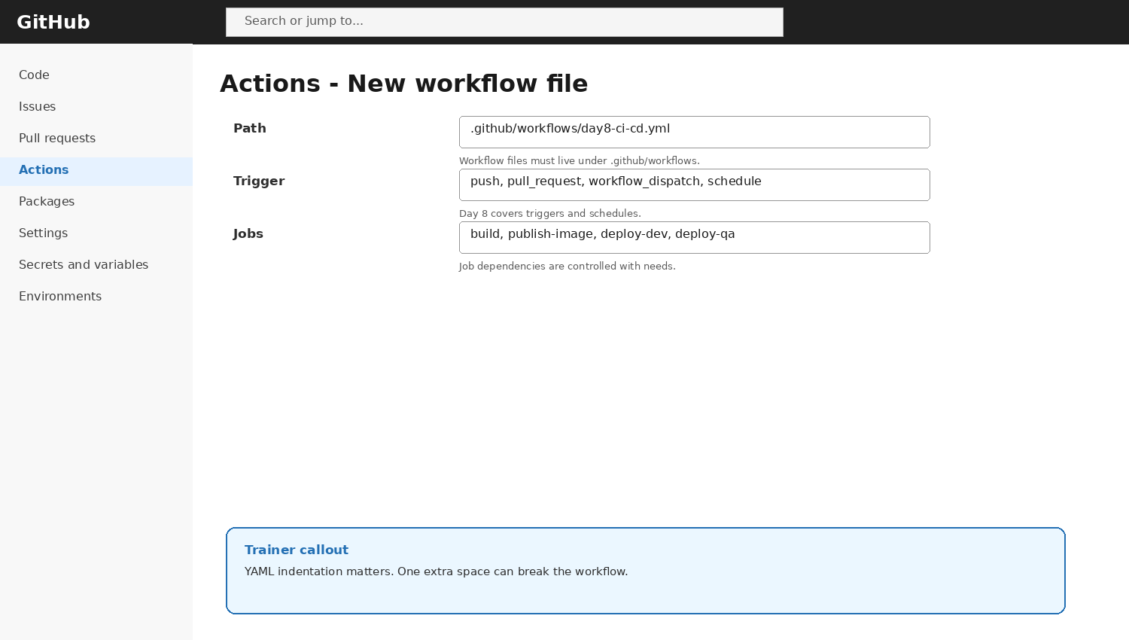
New Workflow File UI
Show this screen during guided walkthrough
Explain values students must enter
Explain what not to change
Validate before proceeding
Capture screenshot for evidence
Day 8 Configure CI Workflow | 76/100

Slide 77

Workflow Run UI
Show this screen during guided walkthrough
Explain values students must enter
Explain what not to change
Validate before proceeding
Capture screenshot for evidence
Day 8 Configure CI Workflow | 77/100

Slide 78

GHCR Package UI
Show this screen during guided walkthrough
Explain values students must enter
Explain what not to change
Validate before proceeding
Capture screenshot for evidence
Day 8 Configure CI Workflow | 78/100

Slide 79
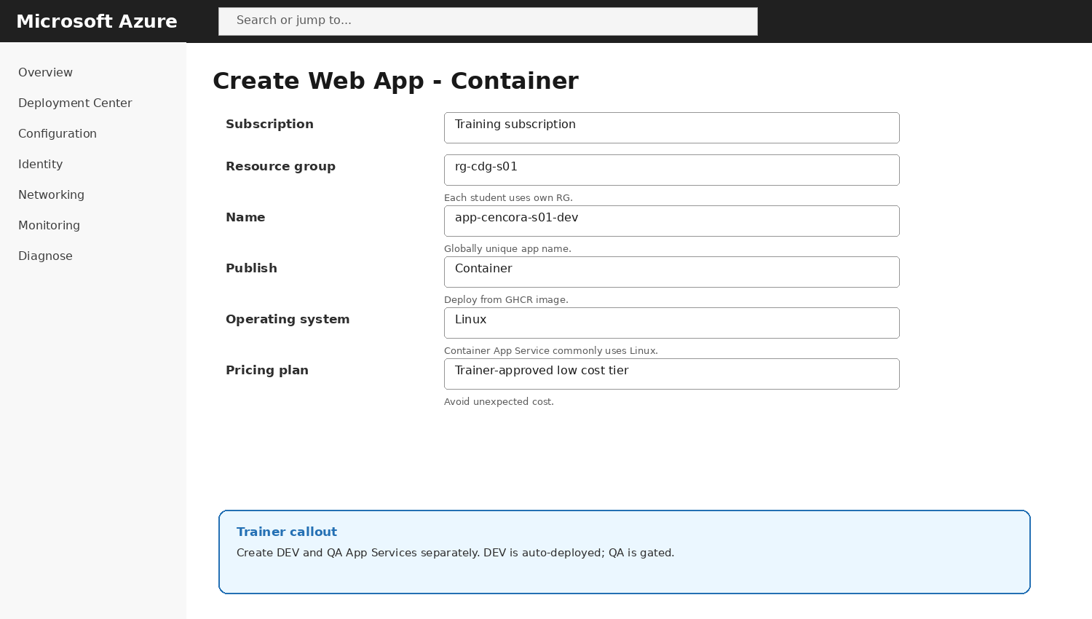
Azure App Service Container UI
Show this screen during guided walkthrough
Explain values students must enter
Explain what not to change
Validate before proceeding
Capture screenshot for evidence
Day 8 Configure CI Workflow | 79/100

Slide 80
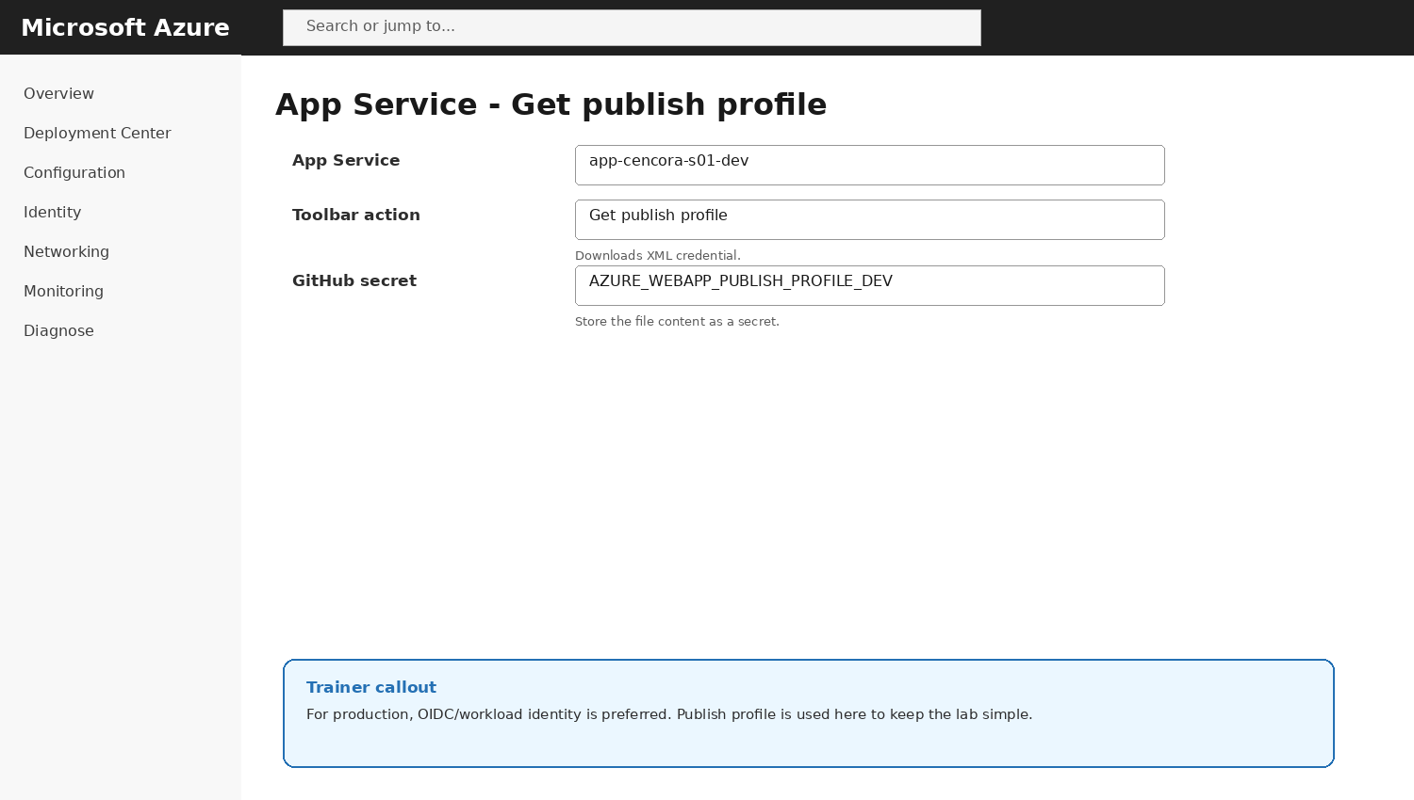
Get Publish Profile UI
Show this screen during guided walkthrough
Explain values students must enter
Explain what not to change
Validate before proceeding
Capture screenshot for evidence
Day 8 Configure CI Workflow | 80/100

Slide 81
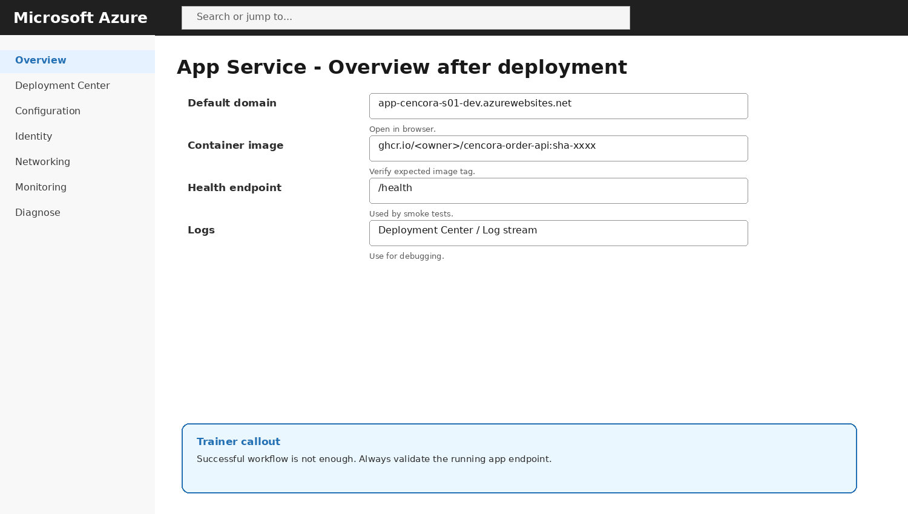
App Service Deployment Validation UI
Show this screen during guided walkthrough
Explain values students must enter
Explain what not to change
Validate before proceeding
Capture screenshot for evidence
Day 8 Configure CI Workflow | 81/100

Slide 82
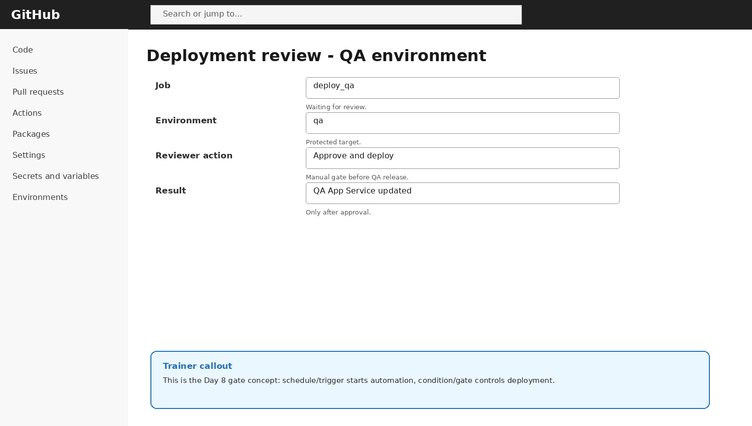
QA Approval Gate UI
Show this screen during guided walkthrough
Explain values students must enter
Explain what not to change
Validate before proceeding
Capture screenshot for evidence
Day 8 Configure CI Workflow | 82/100

Slide 83
Cencora Context
Medicine order API is a training simulation
No real patient or production data
Supply-chain systems need traceability
CI/CD supports controlled releases
Auditability matters in healthcare contexts
push
test
build
deploy
Day 8 Configure CI Workflow | 83/100

Slide 84
Release Traceability
Commit SHA
Workflow run ID
Docker image tag
Environment deployment record
App Service version evidence
push
test
build
deploy
Day 8 Configure CI Workflow | 84/100

Slide 85
Why QA Gate Matters
Avoid accidental QA overwrite
Allow trainer/reviewer check
Simulate change approval
Preserve controlled promotion
Teach deployment governance
push
test
build
deploy
Day 8 Configure CI Workflow | 85/100

Slide 86
DEV vs QA Variables
Different app names
Different publish profiles
Different environment secrets
Same image tag
Different validation endpoints
push
test
build
deploy
Day 8 Configure CI Workflow | 86/100

Slide 87
Smoke Testing
Call /health after deployment
Call /orders with sample JSON
Fail deployment if endpoint unreachable
Can be automated later
Keeps release confidence high
push
test
build
deploy
Day 8 Configure CI Workflow | 87/100

Slide 88
Security Controls
No secrets in YAML
Least privilege permissions
Environment secret scoping
Approval gates
Branch protection
push
test
build
deploy
Day 8 Configure CI Workflow | 88/100

Slide 89
Student Deliverables
Repository URL
Workflow YAML
Successful run
GHCR package
DEV and QA app URLs
push
test
build
deploy
Day 8 Configure CI Workflow | 89/100

Slide 90
Assessment Questions
Explain CI/CD
Explain secrets vs variables
Explain needs and if
Explain QA gate
Troubleshoot failed deployment
push
test
build
deploy
Day 8 Configure CI Workflow | 90/100

Slide 91
Cleanup
Delete unused App Services
Delete unused App Service Plan
Remove package versions if needed
Rotate publish profiles if shared
Keep repo for Day 9
push
test
build
deploy
Day 8 Configure CI Workflow | 91/100

Slide 92
Day 8 Recap
Security first
Build once
Tag immutably
Deploy automatically to DEV
Gate QA release
Code
Build
Image
DEV
Gate
QA
Day 8 Configure CI Workflow | 92/100

Slide 93
Day 8 Practice Discussion 92
What happens if build fails?
What happens if GHCR push fails?
What happens if QA approval is missing?
Which value should be a secret?
How do we prove QA has same image?
push
test
build
deploy
Day 8 Configure CI Workflow | 93/100

Slide 94
Day 8 Practice Discussion 93
What happens if build fails?
What happens if GHCR push fails?
What happens if QA approval is missing?
Which value should be a secret?
How do we prove QA has same image?
push
test
build
deploy
Day 8 Configure CI Workflow | 94/100

Slide 95
Day 8 Practice Discussion 94
What happens if build fails?
What happens if GHCR push fails?
What happens if QA approval is missing?
Which value should be a secret?
How do we prove QA has same image?
push
test
build
deploy
Day 8 Configure CI Workflow | 95/100

Slide 96
Day 8 Practice Discussion 95
What happens if build fails?
What happens if GHCR push fails?
What happens if QA approval is missing?
Which value should be a secret?
How do we prove QA has same image?
push
test
build
deploy
Day 8 Configure CI Workflow | 96/100

Slide 97
Day 8 Practice Discussion 96
What happens if build fails?
What happens if GHCR push fails?
What happens if QA approval is missing?
Which value should be a secret?
How do we prove QA has same image?
push
test
build
deploy
Day 8 Configure CI Workflow | 97/100

Slide 98
Day 8 Practice Discussion 97
What happens if build fails?
What happens if GHCR push fails?
What happens if QA approval is missing?
Which value should be a secret?
How do we prove QA has same image?
push
test
build
deploy
Day 8 Configure CI Workflow | 98/100

Slide 99
Day 8 Practice Discussion 98
What happens if build fails?
What happens if GHCR push fails?
What happens if QA approval is missing?
Which value should be a secret?
How do we prove QA has same image?
push
test
build
deploy
Day 8 Configure CI Workflow | 99/100

Slide 100
Day 8 Practice Discussion 99
What happens if build fails?
What happens if GHCR push fails?
What happens if QA approval is missing?
Which value should be a secret?
How do we prove QA has same image?
push
test
build
deploy
Day 8 Configure CI Workflow | 100/100

